Slide 1

DIY IOT on a Dime
Developing and integrating remote sensors.

Slide 2
Scott Raznoff, GISP
GIS Analyst, GIS Coordinator City of Helena UMD (Water, Sewer, Storm)

Slide 3

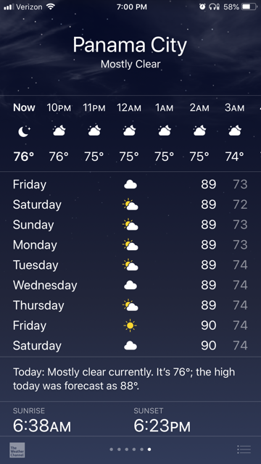
February, 2019

Slide 4
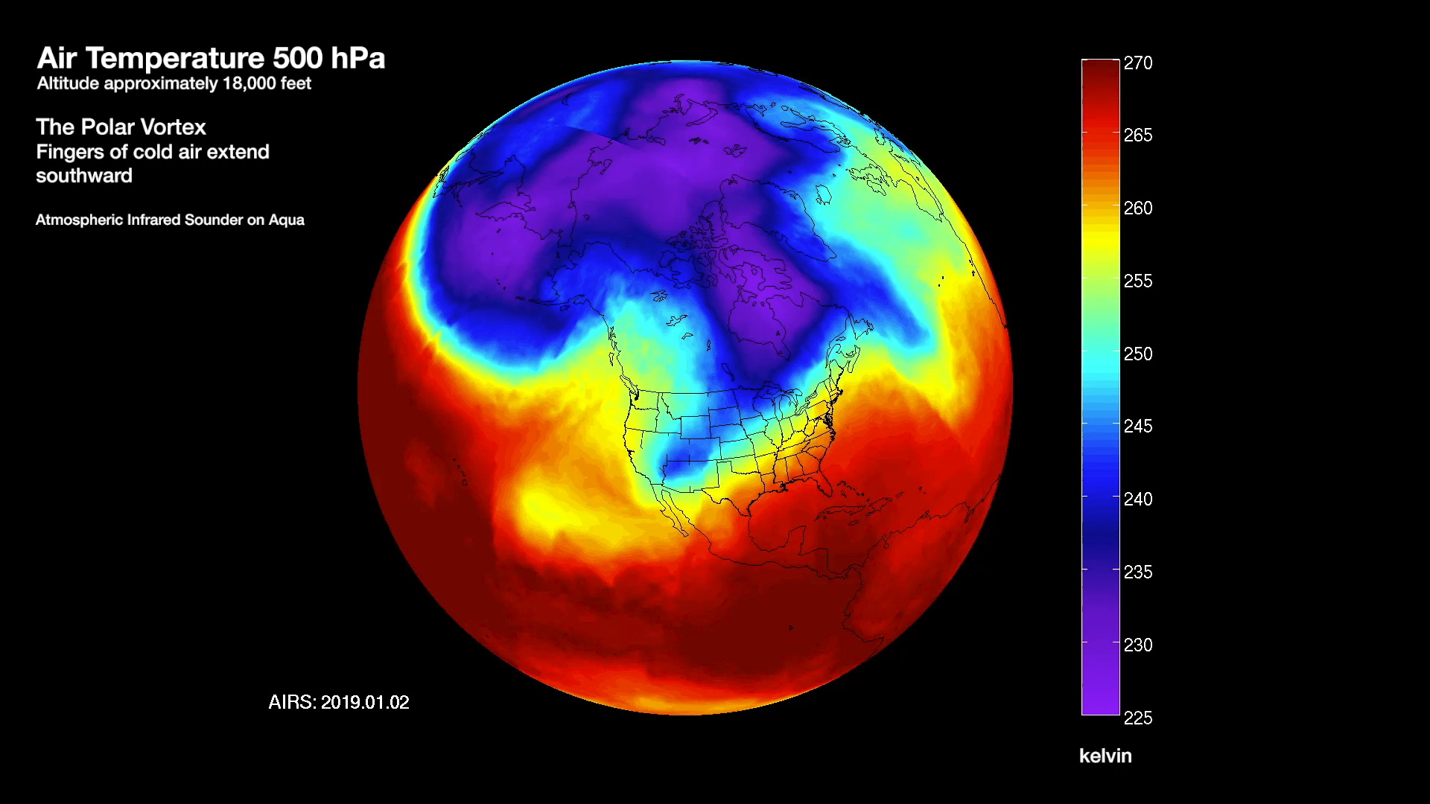
https://airs.jpl.nasa.gov/resources/219/polar-vortex-air-temperature-at-500-hpa-january-march-2019/

Slide 5
https://www.wunderground.com/history/monthly/us/mt/helena/KHLN/date/2019-1
https://www.wunderground.com/history/monthly/us/mt/helena/KHLN/date/2019-2
https://www.wunderground.com/history/monthly/us/mt/helena/KHLN/date/2019-3

Slide 6
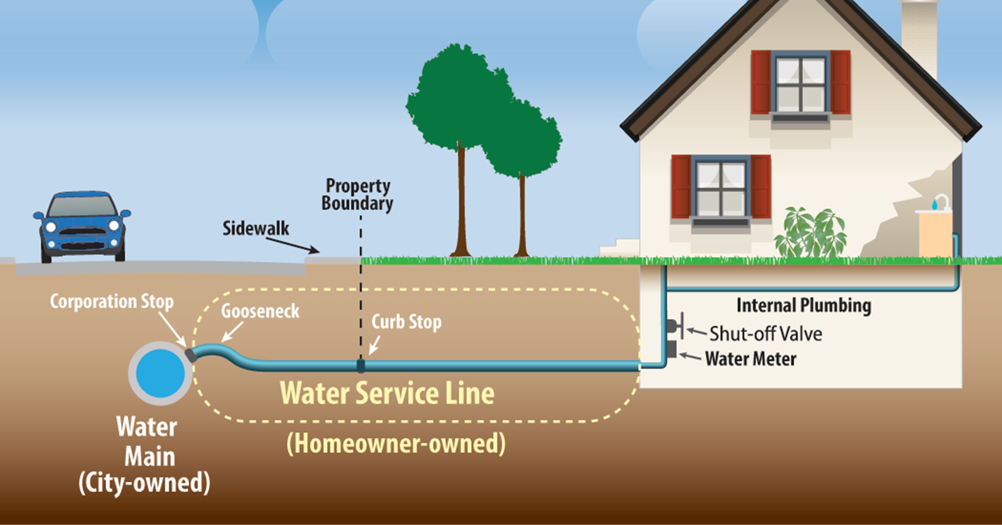
Vulnerability

Slide 8
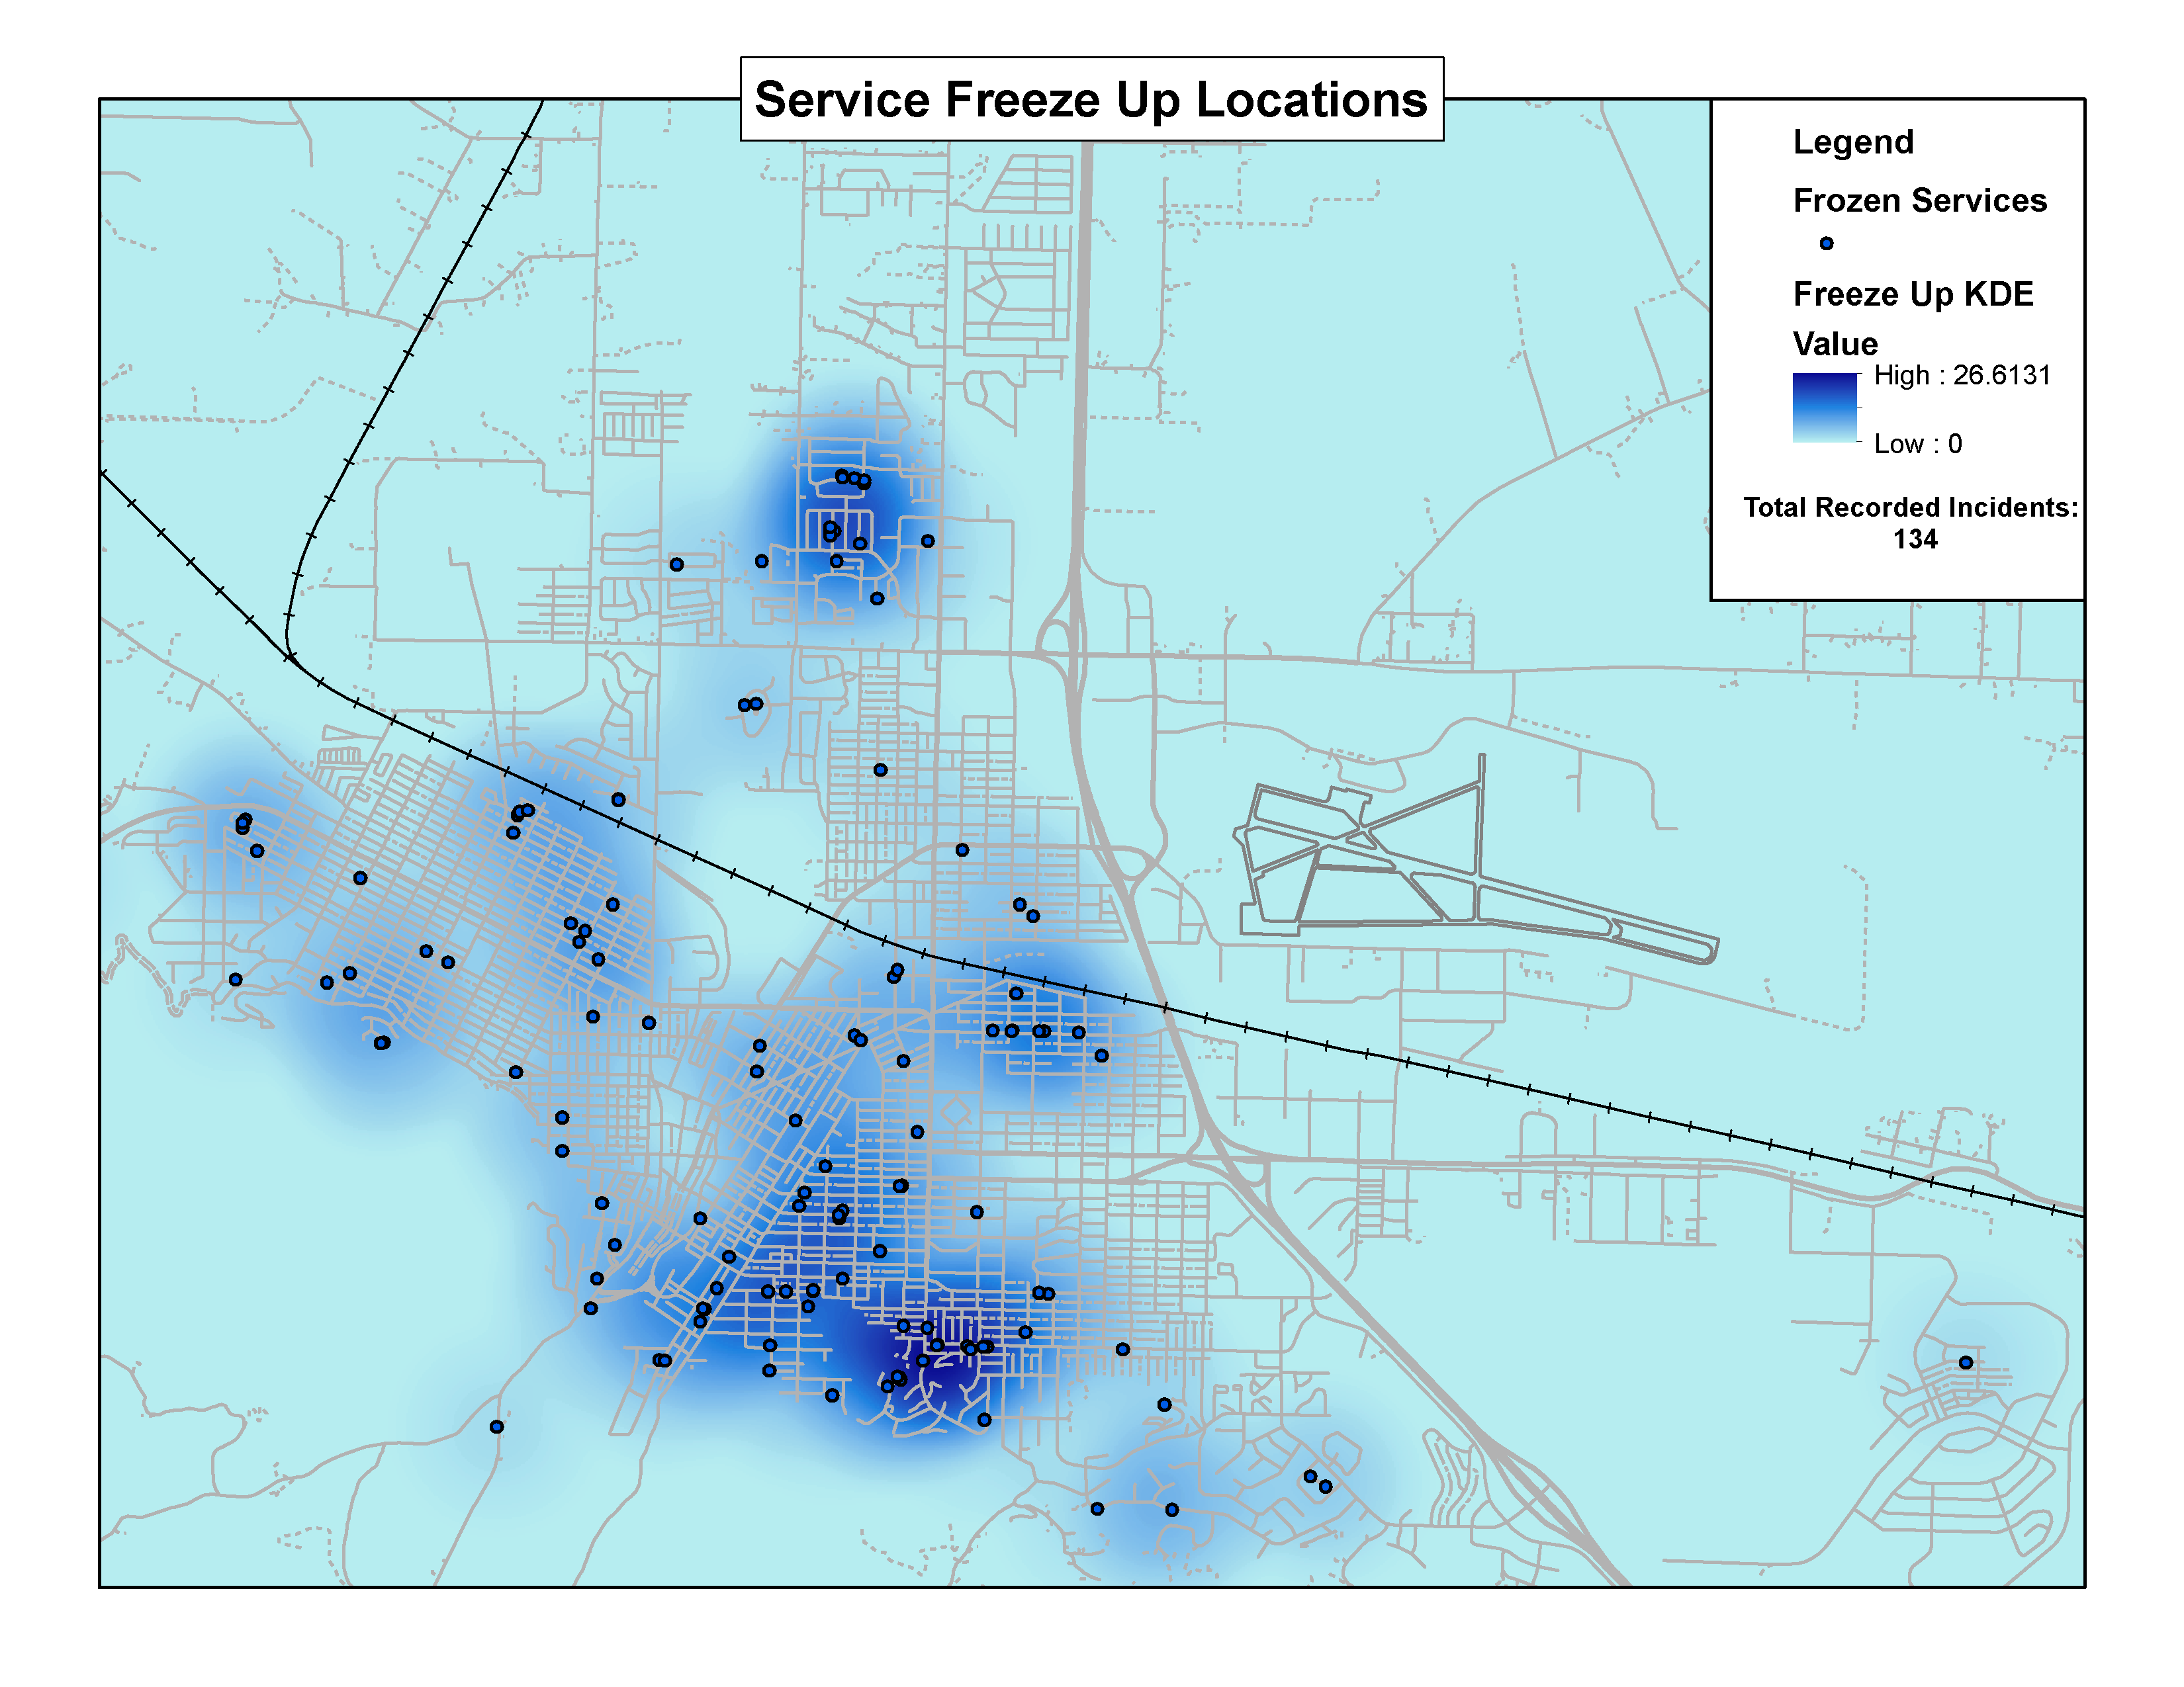

Slide 9
Looking For Solutions
City Ownership
Monitoring / Warning System
-Digs
-Other Agencies
-Commercial System
-Electrical Engineer
Sawka, et.al. (2016) IoT: A Frost Penetration Sensor Network
D. Sawka1 , M. Frost1 , D.P.U. Tran1 , S. Virk1 , J. Blatz2 and R.D. McLeod. (2016). IoT: A Frost Penetration Sensor Network. Worldcomp-Proceedings.Com. http://worldcomp-proceedings.com/proc/p2016/ICM3313.pdf

Slide 10
Close & Developed
D. Sawka1 , M. Frost1 , D.P.U. Tran1 , S. Virk1 , J. Blatz2 and R.D. McLeod. (2016). IoT: A Frost Penetration Sensor Network. Worldcomp-Proceedings.Com. http://worldcomp-proceedings.com/proc/p2016/ICM3313.pdf

Slide 11
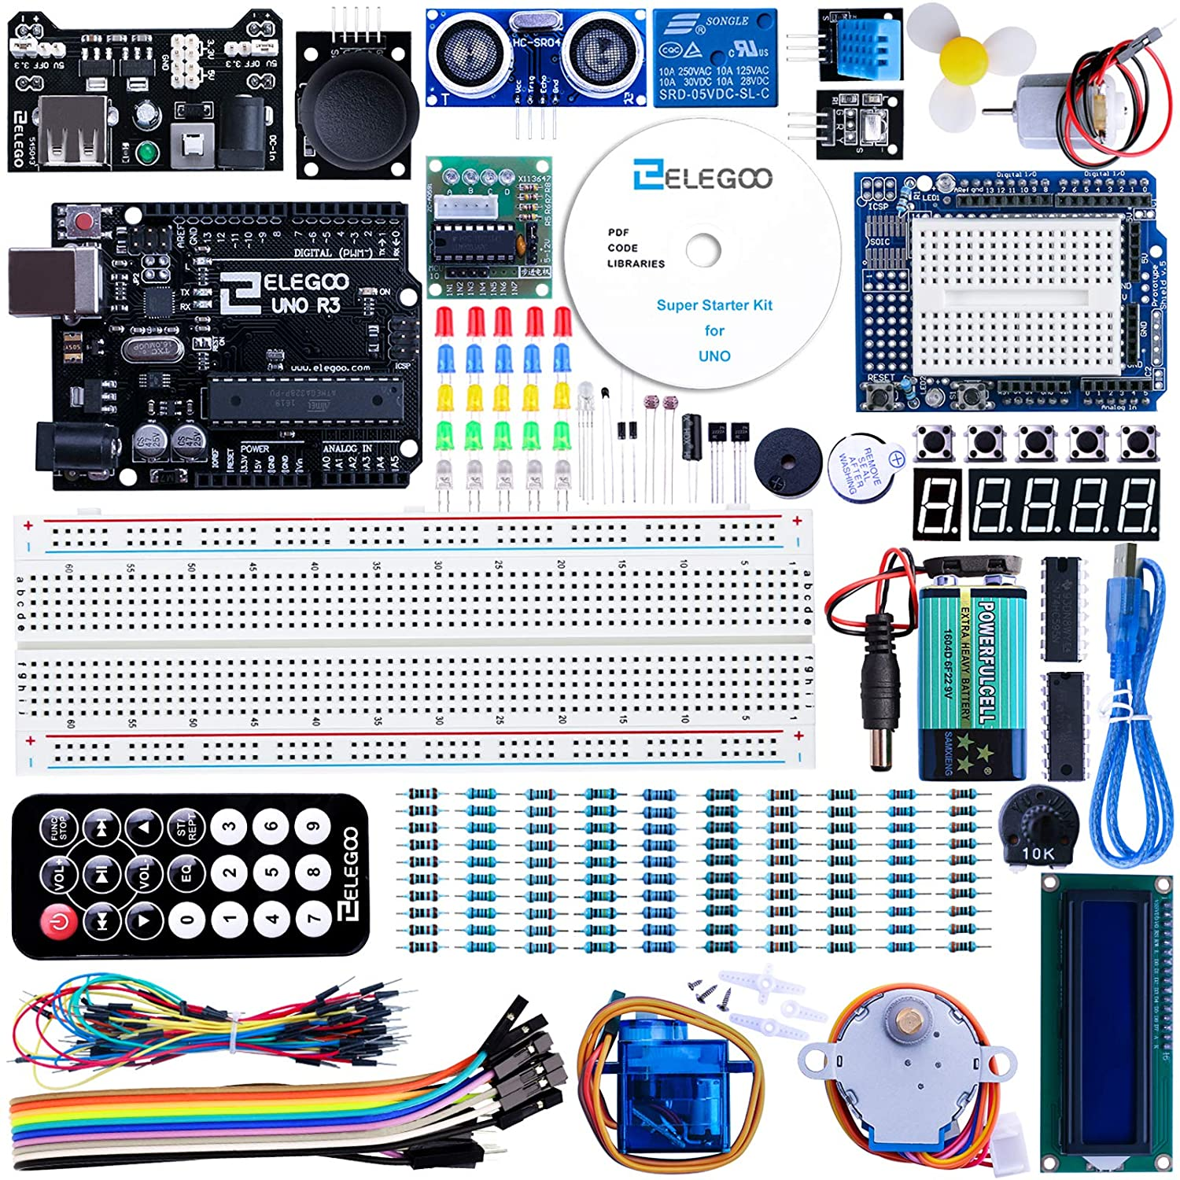
Learning the hard way

Slide 12
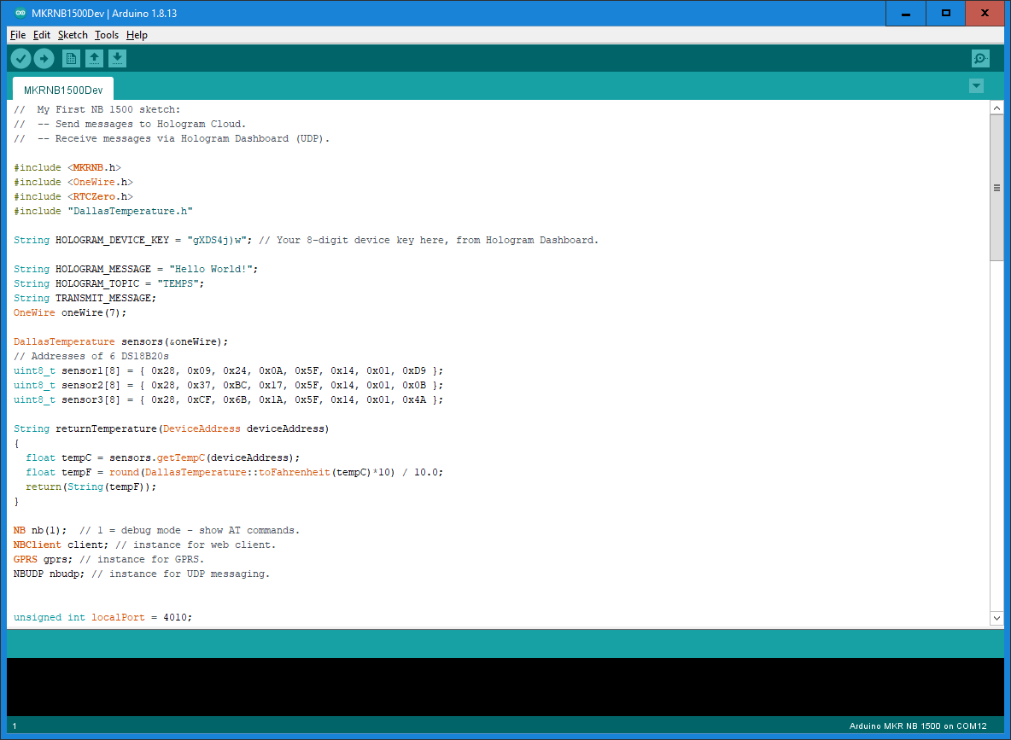
Arduino
Environment

Slide 13
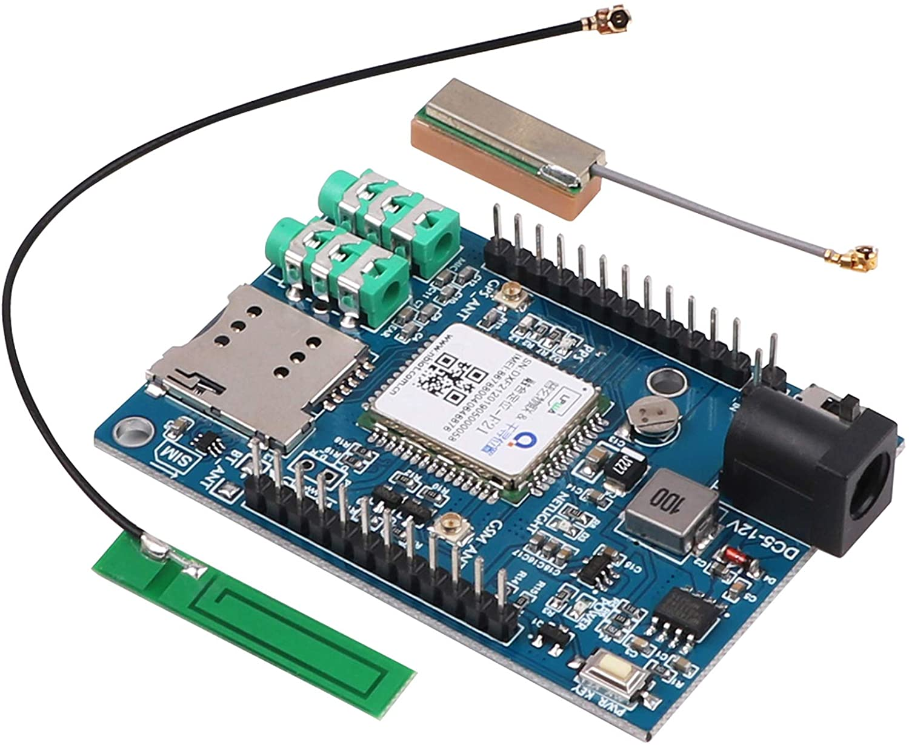
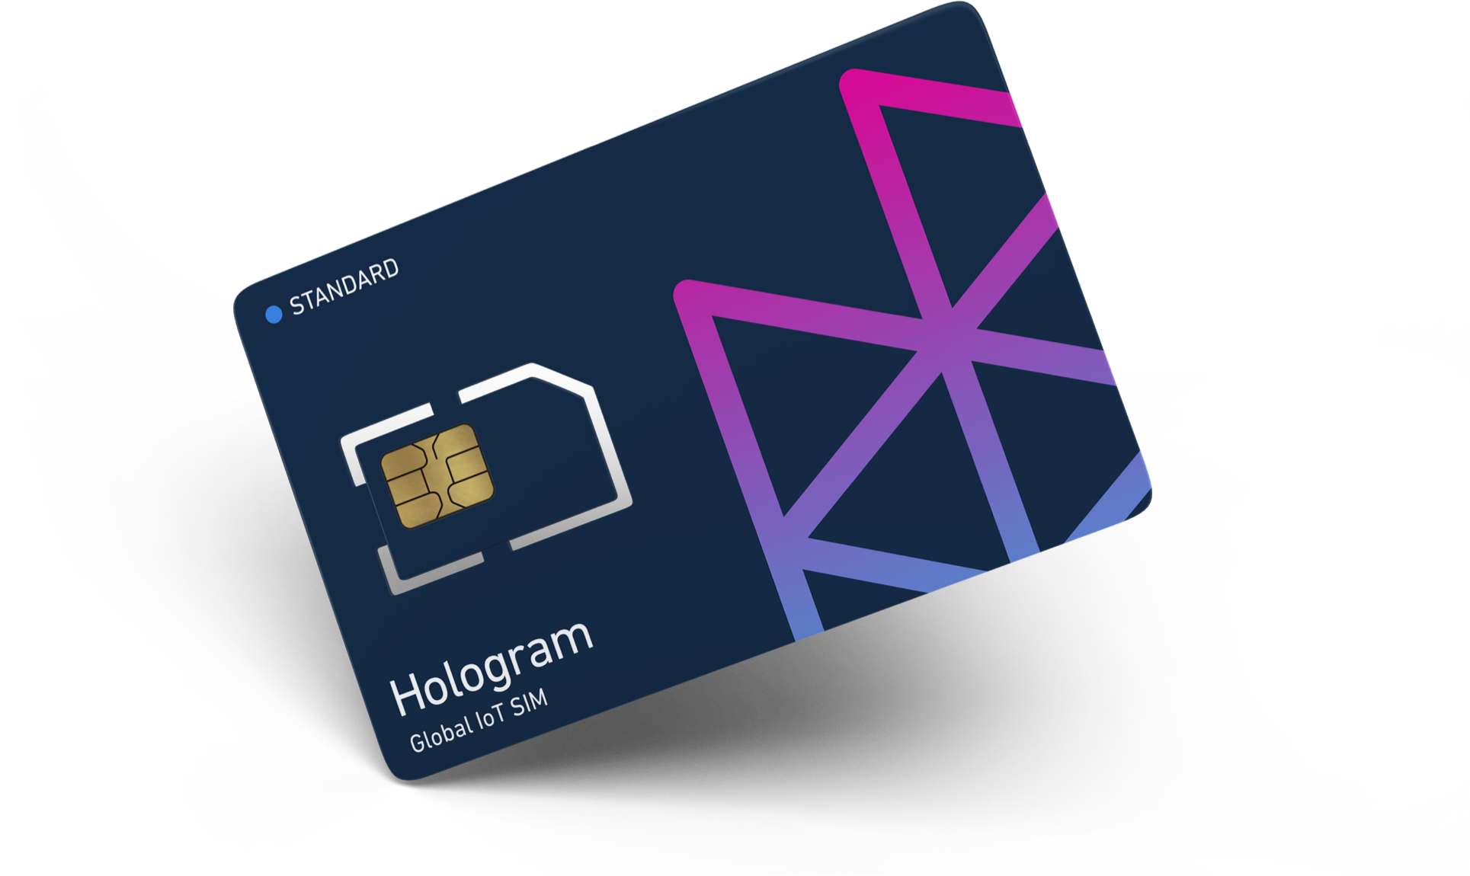
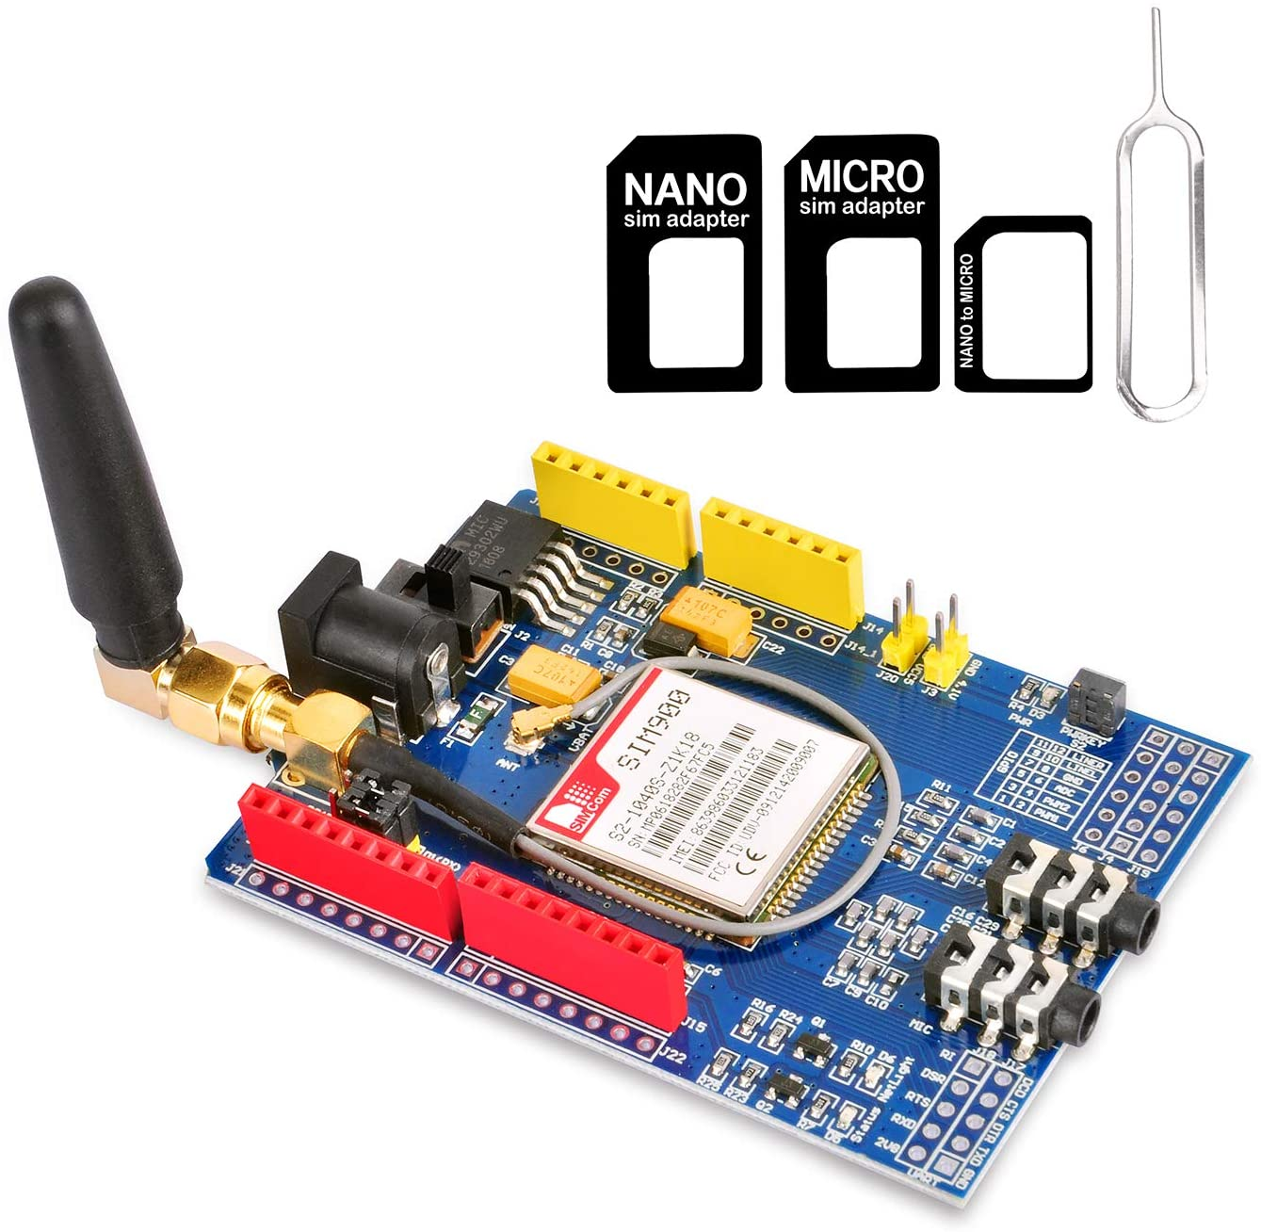
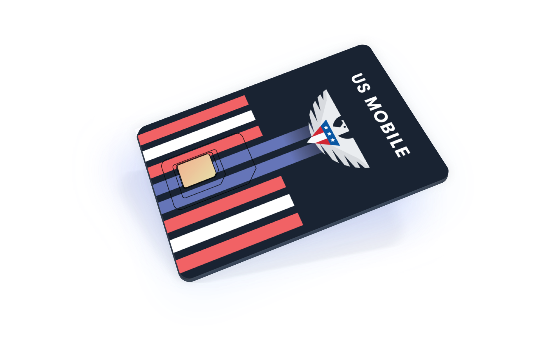
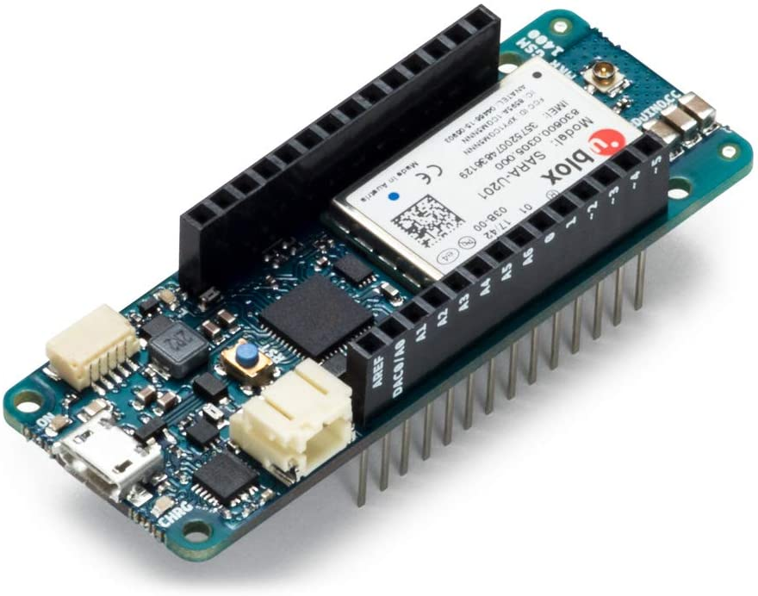
Trial and Error

Slide 14
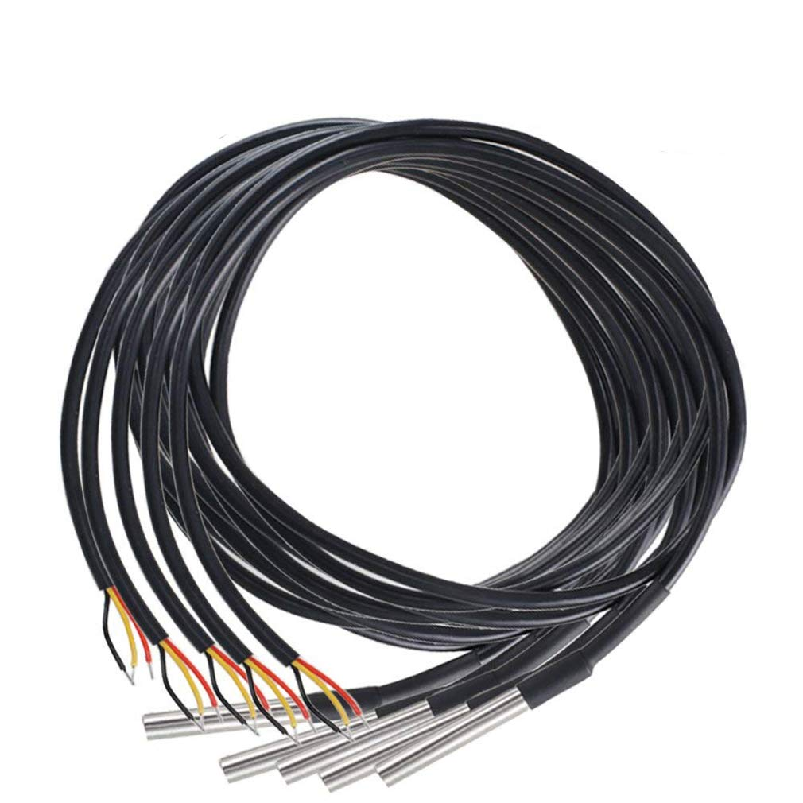
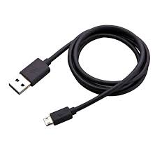
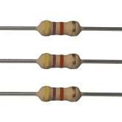
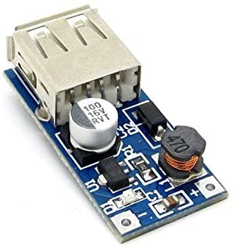
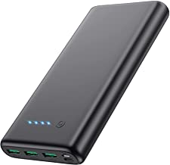
The winning recipe
DS18B20 Sensors | $ 14.99
Arduino Mkr nb 1500 | $ 77.00
Hologram Sim (1 yr, 1MB/Mo) | $ 9.36
Power Bank | $ 19.99
5v stepup charger | $ 8.99
4.7 Ohm Resistor | $ 6.53
Total | $ 136.86

Slide 15
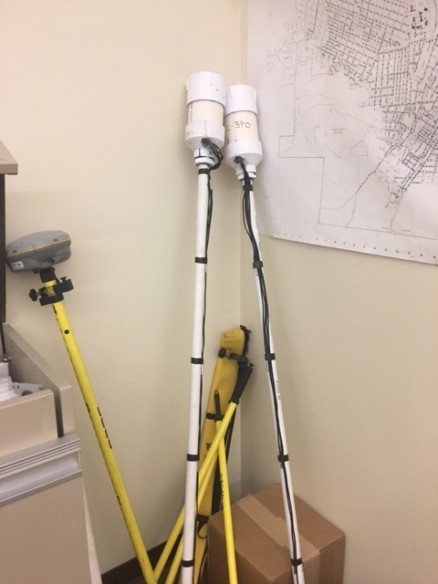
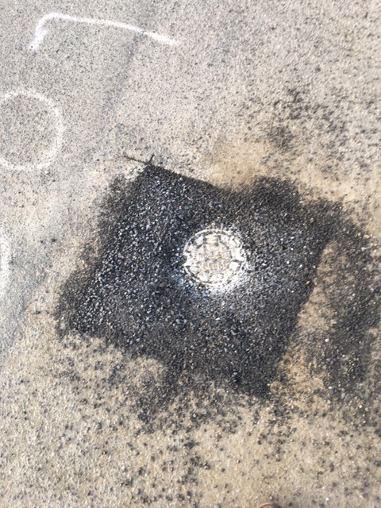
Sensors in the wild

Slide 16
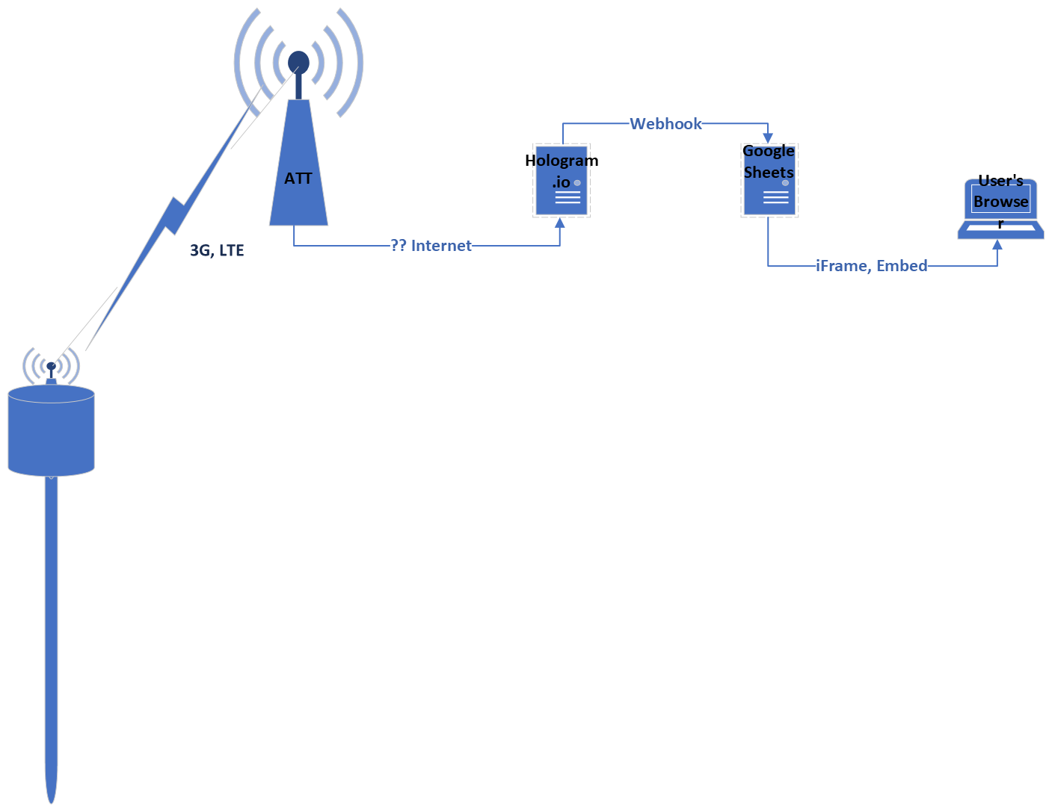
How things talk

Slide 17
Codebase
#include <OneWire.h>
#include <MKRGSM.h>
#include "DallasTemperature.h"
#include <RTCZero.h>
#include "ArduinoLowPower.h"
const char PINNUMBER[] = " ";
// APN data
const char GPRS_APN[] = "hologram";
const char GPRS_LOGIN[] = " ";
const char GPRS_PASSWORD[] = " ";
String HOLOGRAM_DEVICE_KEY = “XXXXXXXX”
String HOLOGRAM_MESSAGE;
String HOLOGRAM_TOPIC = "TEMPS";
OneWire oneWire(7);
DallasTemperature sensors(&oneWire);
// Addresses of 6 DS18B20s
uint8_t sensor1[8] = { 0x28, 0xAA, 0xBD, 0x06, 0x55, 0x14, 0x01, 0xE0 };
uint8_t sensor2[8] = { 0x28, 0xAA, 0xDA, 0x16, 0x55, 0x14, 0x01, 0x98 };
uint8_t sensor3[8] = { 0x28, 0xAA, 0xD6, 0xE5, 0x54, 0x14, 0x01, 0xEB };
uint8_t sensor4[8] = { 0x28, 0xAA, 0x82, 0x0D, 0x55, 0x14, 0x01, 0x9F };
uint8_t sensor5[8] = { 0x28, 0xAA, 0x21, 0x17, 0x55, 0x14, 0x01, 0xC1 };
uint8_t sensor6[8] = { 0x28, 0xAA, 0x6D, 0xED, 0x54, 0x14, 0x01, 0xC8 };
// initialize the library instance
GSMClient client;
GPRS gprs;
GSM gsmAccess;
// Hologram's Embedded API (https://hologram.io/docs/reference/cloud/embedded/) URL and port
char server[] = "cloudsocket.hologram.io";
int port = 9999;
String returnTemperature(DeviceAddress deviceAddress)
{
float tempC = sensors.getTempC(deviceAddress);
float tempF = round(DallasTemperature::toFahrenheit(tempC)*10) / 10.0;
return(String(tempF));
}
void setup() {
// put your setup code here, to run once:
// Serial.begin(9600);
}
void loop() {
sensors.begin();
//while (!Serial) {
; // wait for serial port to connect. Needed for native USB port only
// }
delay(10000);
sensors.requestTemperatures();
delay(1000);
int sensorValue = analogRead(ADC_BATTERY);
HOLOGRAM_MESSAGE = returnTemperature(sensor1) + "," +returnTemperature(sensor2) + "," +returnTemperature(sensor3) + "," +returnTemperature(sensor4)+","+returnTemperature(sensor5)+","+returnTemperature(sensor6)+","+String(sensorValue);
//- HOLOGRAM_MESSAGE = String(sensorValue);
boolean connected = false;
// After starting the modem with GSM.begin()
// attach to the GPRS network with the APN, login and password
while (!connected) {
// Serial.println("Begin gsm Access");
//Serial.println(gsmAccess.begin()); //Uncomment for testing
if ((gsmAccess.begin() == GSM_READY) &&
(gprs.attachGPRS(GPRS_APN, GPRS_LOGIN, GPRS_PASSWORD) == GPRS_READY)) {
connected = true;
// Serial.println("GSM Access Success");
}
else {
// Serial.println("Not connected");
delay(1000);
}
}
// Serial.println("connecting...");
// if you get a connection, report back via serial:
if (client.connect(server, port)) {
// Serial.println("connected");
// Send a Message request:
client.println("{\"k\":\"" + HOLOGRAM_DEVICE_KEY +"\",\"d\":\""+ HOLOGRAM_MESSAGE+ "\",\"t\":\""+HOLOGRAM_TOPIC+"\"}");
delay(10000);
//client.disconnect();
gsmAccess.shutdown();
LowPower.deepSleep(21600000);
//delay(21600000);
//delay(10000);
// Serial.println(HOLOGRAM_MESSAGE);
} else {
// if you didn't get a connection to the server:
// Serial.println("connection failed");
}
}
/*void returnTemperature(DeviceAddress deviceAddress)
{
float tempC = sensors.getTempC(deviceAddress);
float tempF = round(DallasTemperature::toFahrenheit(tempC)*10) / 10.0;
return(tempF)
}
*/
//R2D2 CODE
//this is a function that fires when the webapp receives a GET request
function doGet(e) {
return HtmlService.createHtmlOutput("request received");
}
//Testing that this is per page and not workbook
//this is a function that fires when the webapp receives a POST request
function doPost(e) {
var params = JSON.stringify(e.postData.contents);
//var myData = JSON.parse(e.postData.contents);
var sheet = SpreadsheetApp.getActiveSheet();
sheet.getRange(1, 1).setValue(params);
SpreadsheetApp.flush();
return HtmlService.createHtmlOutput("post request received");
}

Slide 18
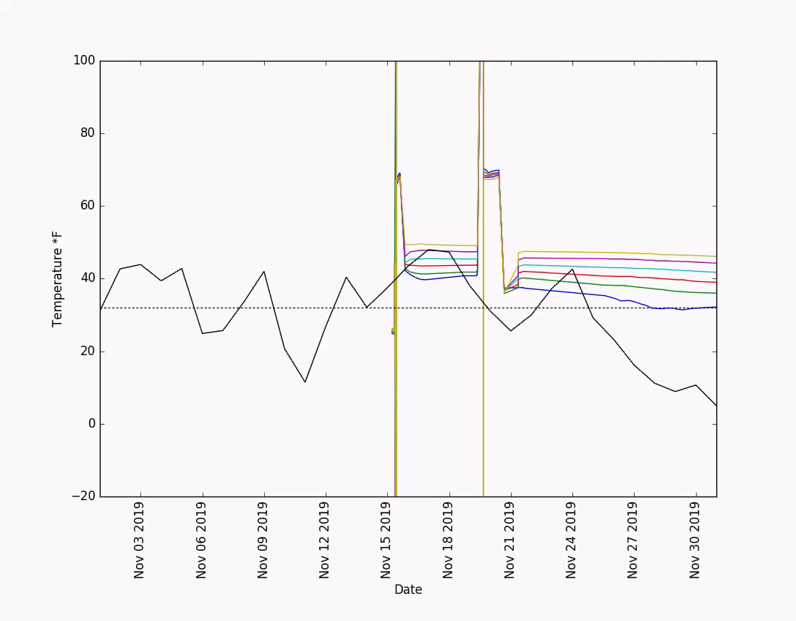
Dataset

Slide 19
Helpful Resources and Q&A
Arduino NB1500 SARA-R410M Firmware Update | No Modem Connection Fix
Forum.Arduino.cc
http://worldcomp-proceedings.com/proc/p2016/ICM3313.pdf

